Slide 1
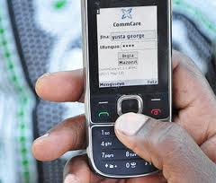
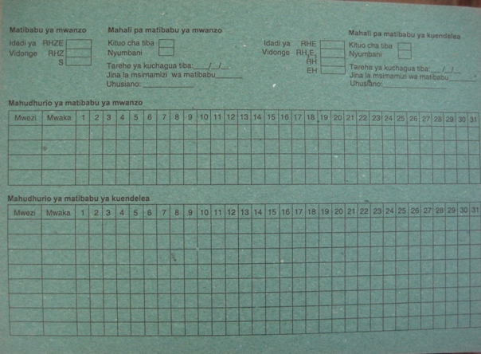
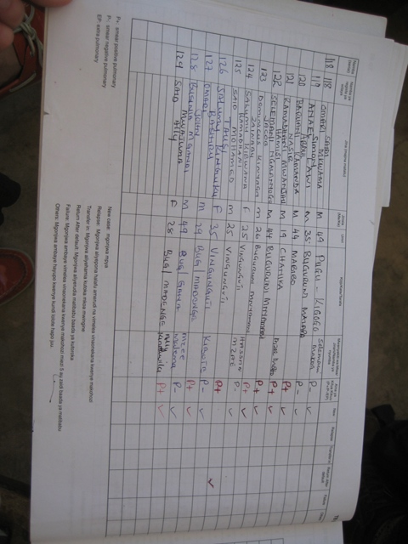
Computing and Global Health Lecture 3 Last mile data collection and Tracking
Winter 2015
Richard Anderson

Slide 2
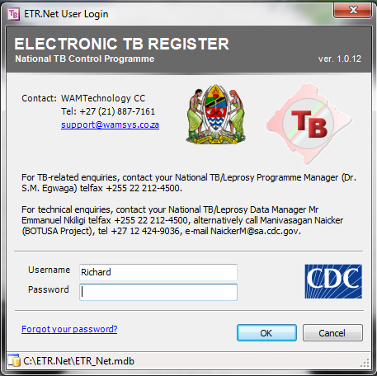
Today’s topics
Readings and assignments
Cold chain assignment review
HISP Case study – Ghana
Last mile data reporting
Tracking vs. Surveillance
Electronic Registers
Challenges

Slide 3
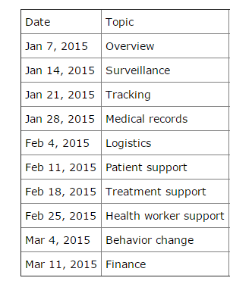
Readings and Assignments
Homework 2
Requirements for aggregating facility reports
Readings
DHIS2 Tracker, Saugene
Generic Software Systems
Child Health Information Services
Biometrics papers

Slide 4
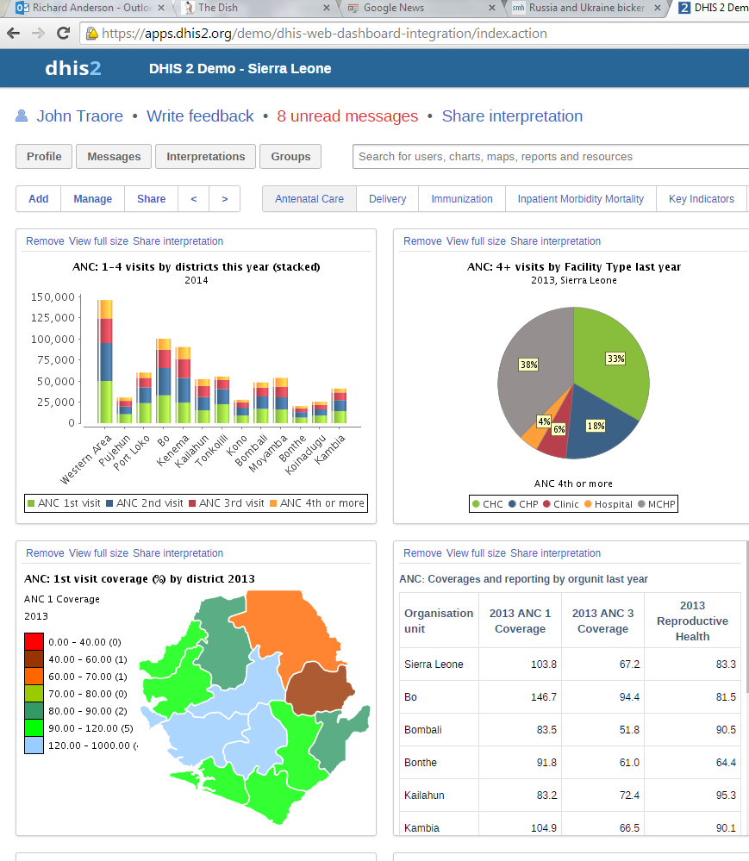
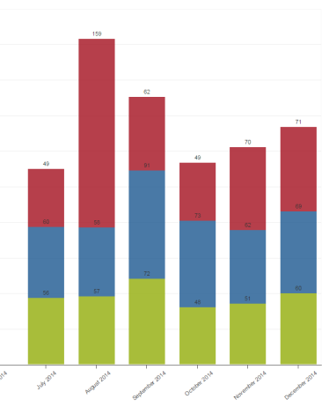
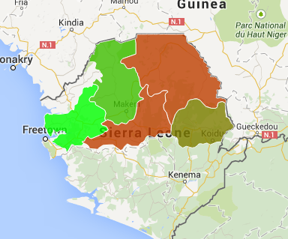
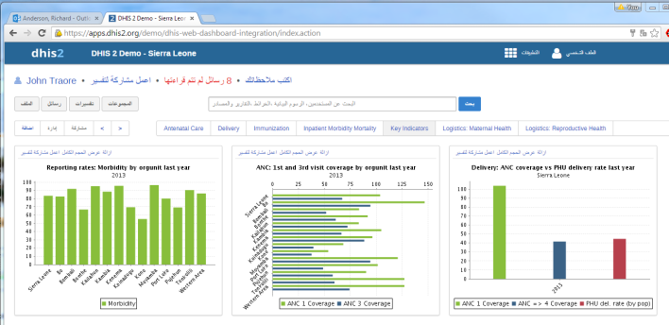
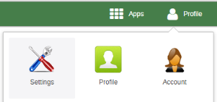
Assignment 3
DHIS2 Assignment
Questions to fahadp@cs

Slide 5
Cold chain data reporting
Distribution of countries
Burden of Disease
Cold chain reporting
Design a system for reporting ‘up time’ of all refrigerators
National surveillance problem
Indicator was identified
Challenges in getting data, transmitting data, interpreting data

Slide 6
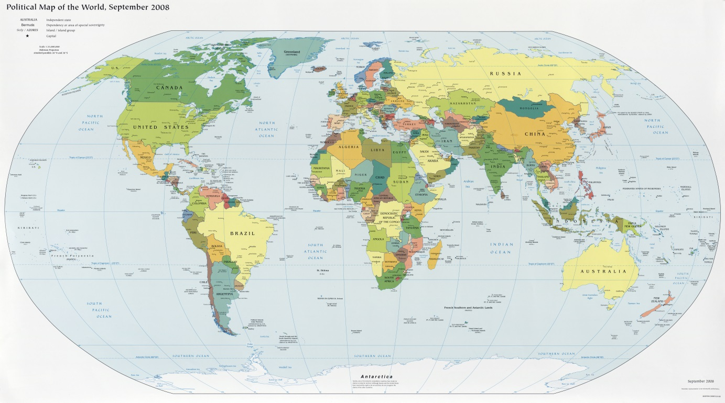
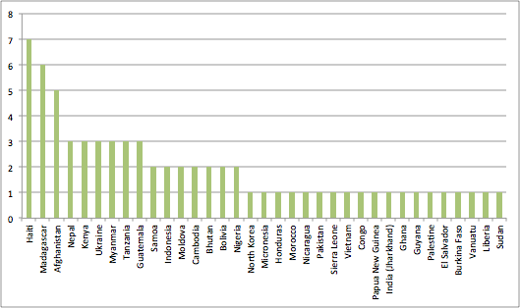

Slide 7
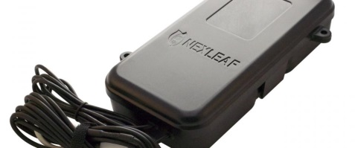
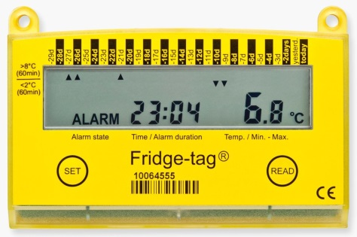
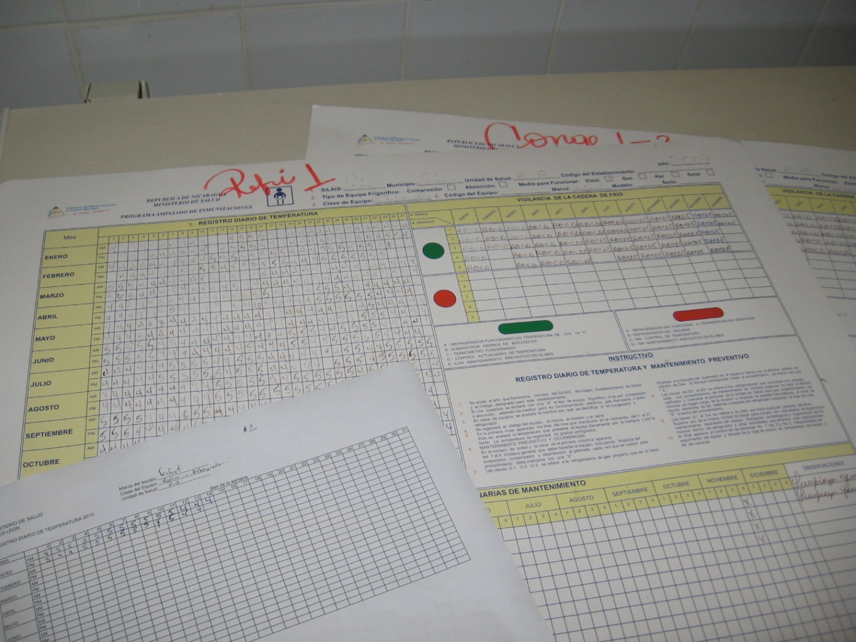
Cold chain data reporting
Automated reporting linked to server
Real time temperature monitoring
Reporting on temperature loggers
Reporting of status in monthly report
Link to existing structures
Monthly immunization reporting
Refrigerator repair
District immunization management

Slide 8
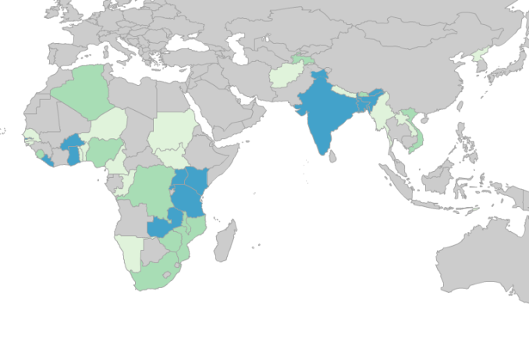
Surveillance summary
Aggregate data to evaluate the strength of the health system or to meet external requirements
Indicators
Data challenges
Integrated vs. Parallel reporting
DHIS2

Slide 9
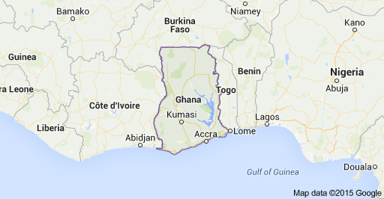
HISP Case Study
Ghana

Slide 10
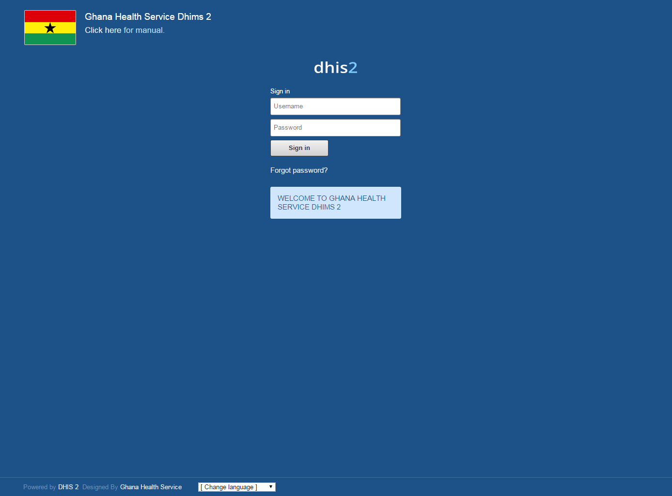
HISP Case studies

Slide 11
Health Information Systems
Challenges
Collection of irrelevant data
Poor data quality
Poor timeliness of reporting
Parallel and duplicate data collection
Low information usage and poor feedback
Donor driven reporting
Lack of requested data elements in national reporting
Development of parallel reporting systems

Slide 12
DHIMS
2007: Roll out of District Health Information Management System
2008: Health Metrics Network (HMN), framework for integrated HIS
2011: Implementation of DHIMS2 in DHIS2

Slide 13
DHIMS2 vs. DHIMS
Centralization of expertise
Greater expertise needed, but can be centralize
Improved data flow and reporting speed
Increased access to information
No longer restricted to a local database
Consistent national deployment
Avoid inconsistent development in different areas
Substantial capacity development

Slide 14
Why Open Source?
OpenMRS
Open Data Kit
DHIS2
Open LMIS
. . .

Slide 15
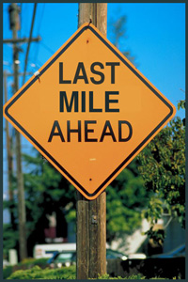
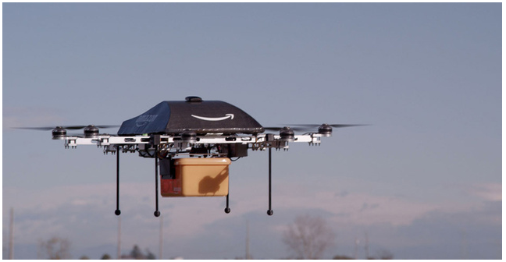
Last mile data reporting
Collecting data from health facilities
Issues
Limits on infrastructure
Technical background of data reporters
Incentives of data reporters
Ownership of technology
Model for data collecting

Slide 16
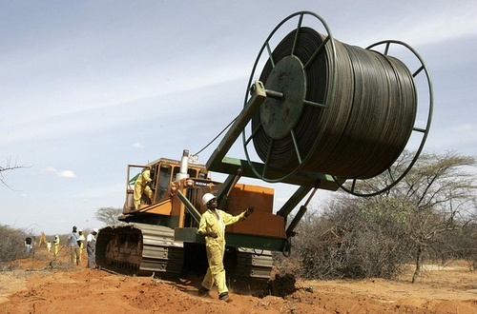
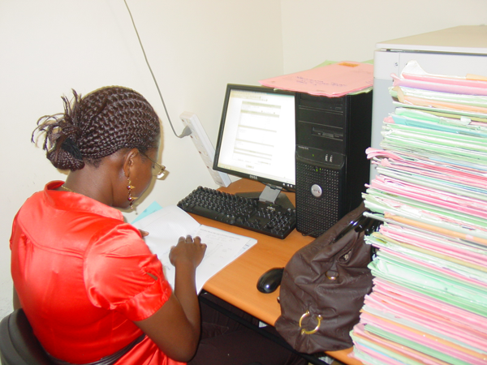
Internet
Must be considered as an option
Challenges of maintaining a computer at remote sites
Need to support online/offline data entry

Slide 17
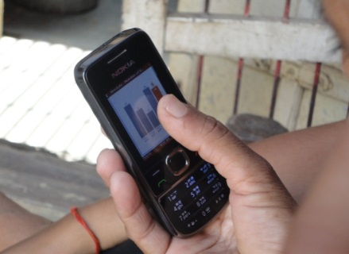
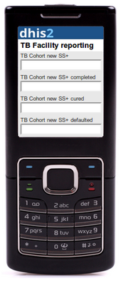
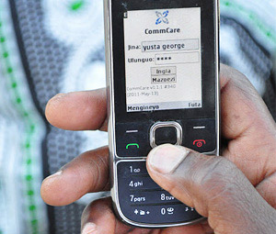
Feature phone
Java phones to run applications
Interest in the technology has declined
Projects generally targeted a small range of models as portability of applications a challenge
Feature phones retain some market share as multimedia phones
Series of mobile phone applications based on XForms

Slide 18
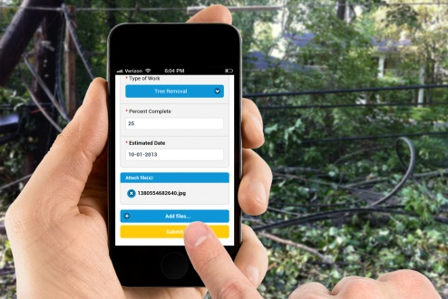
Smart phone / ODK
Growing interest in utilizing Smart Phones
Cost and programmability drive interest in Android
Open Data Kit
University of Washington developed system for data collection on mobile phones
Forms based application running on Phone
Back end system for aggregating submissions
Goal to make it easy for organizations to deploy survey tools on smart phones
Example: IHME deployment of verbal autopsy tool
Common approach, collect data on a tablet, and sync data by wifi when back in the office

Slide 19
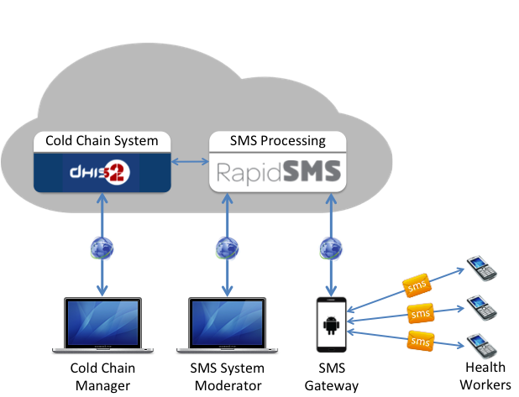
SMS
Data submission by raw text messages, interpreted by server
In many cases, it can be assumed everyone has access to an SMS phone
Challenges if a large amount of data is required
FT B23
SL
P10D35

Slide 20
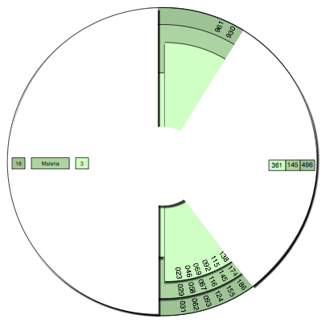
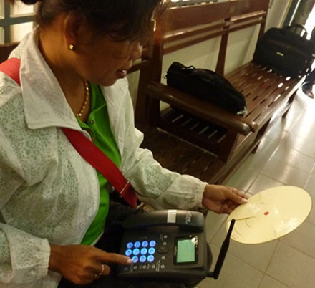
SMS Wheel
Attempt to simplify SMS reporting by giving a job aid to convert data into a numeric code with a checksum

Slide 21
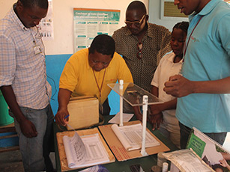
Paper to Digital
Scan paper forms
Allows entry on paper (which is easier)
Reduces manual entry
More later . . .

Slide 22
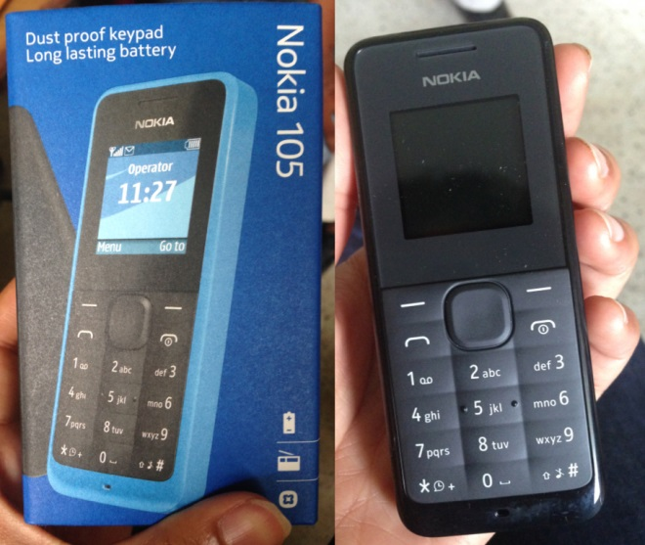
Device ownership
Personally owned versus provided devices
Computers – generally facility devices
Mobile phones
Personal
Cheaper to the project
Incentives to keep charged
Heterogeneous
Must support lowest common denominator
Provided
Can be costly
Substantial effort to manage
Security risks
Training
Allow uniform deployment environment
Can be a mismatch with target users
Potential for cross project utilization

Slide 23
Who collects the data
Health workers
Dedicated data collectors
Derived or automatically collected

Slide 24
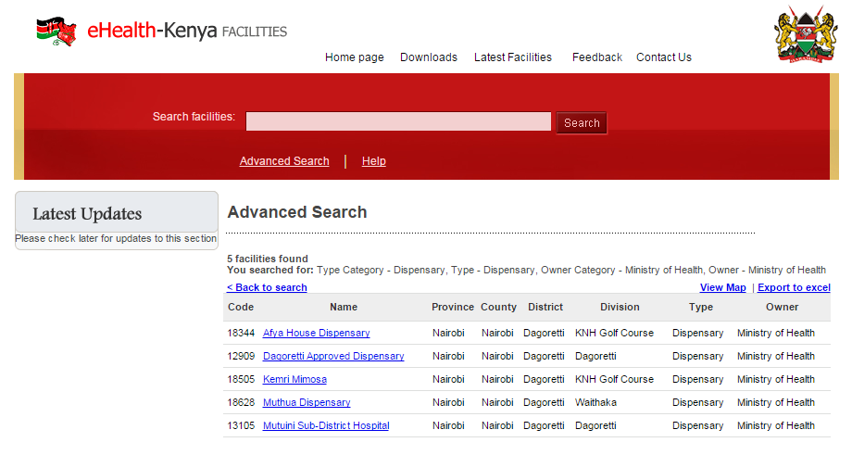
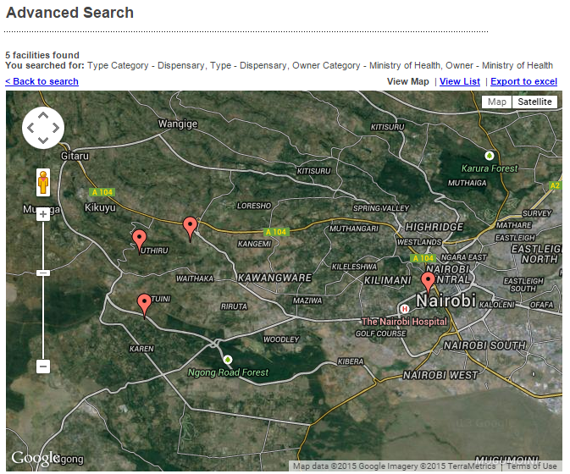
Health Information Systems challenge: Generating a Master Facility List
MFL – list of all health facilities in the country
Facility ID (Primary key)
Classification by services
Best case: Kenya
http://www.ehealth.or.ke/facilities/

Slide 25
Challenges in building MFL
List all public health facilities
Determine which ones are active
Identify new facilities
Resolve duplicate names
Determine other types of facilities to include
Private, Faith based
Establish unique ID codes
Central administration of list

Slide 26
Laos Facility List, MOH vs NIP
0803001 | 80301 | Phoulaeng | ພູ​ແລ້ງ|Phuleng
0803002 | 80302 | Thasouang | ທ່າ​ຊ່ວງ|Thasuang
0803003 | 80303 | KhokAek | ຄົກ​ແອກ|Kockeak
0803004 | 80304 | Napoung | ນາ​ປຸ່ງ |Napung
0803005 | 80305 | Namsib | ນ້ຳ​ສິບ|Namsip
0803006 | 80306 | Ban Harn | ຫານ|Han
0804001 | 80401 | BanThong | ບ້ານ​ທອງ|Banthong
0804002 | 80402 | HouaiGneui | ຫ້ວຍ​ເງີຍ|Huaunhuen
0804003 | 80403 | NaNhang | ນາ​ຍາງ|Nanhang
0804004 | 80404 | Pnagbong | ປາງ​ບົງ|Pangbong
0804005 | 80405 | Phadaeng | ຜາ​ແດງ|Phadeng
0804006 | 80406 | Houaipheuang | ຫ້ວຍເຜິ້ງ|Haupheug
0805001 | 80501 | Phoulane | ປາກ​ເປັດ|Pakpet
0805002 | 80502 | Parkpet | Dong
0805003 | 80503 | Dong | Homso
0805004 | 80504 | Holmxai | Huamueng
0805005 | 80505 | Houameuang | Huana
0805006 | 80506 | Houana | Huaunhouck
0805007 | 80507 | HouaiYourk | Phulan (Thonhkang)
0806001 | 80601 | Naxing | ນາ​ຊິງ|Nasing
0806002 | 80602 | Nakhaem | ນາ​ແຄມ|Nakhem
0806003 | 80603 | Phadam | ຜາ​ດຳ|Phadam
0806004 | 80604 | Navaen | ນາ​ແວນ /(ນາສຳພັນ)|Naven/Nasamphan
0806005 | 80605 | Pholthong | ໂພນ​ທອງ|Phonthong
0806006 | 80606 | PholsaArd | ໂພນສະ​ອາດ|Phonsaaat
0806007 | 80607 | Pongvang | ປົ່ງ​ວາງ|Pongvang
0806008 | 80608 | Holmxai | ໂຮມໄຊ(ນ້ຳງື່ມ)|Homsay/Namnhuem

Slide 27
Registers
What are registers
Surveillance vs. Tracking vs. Medical Records

Slide 28
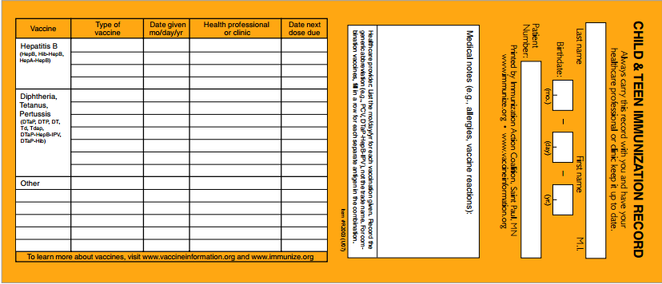
Register definitions
class ImmunizationRecord {
int UniqueID;
String Name;
Date BirthDate;
ImmunizationData immunizations;
}
ImmunizationRecord[ ] immunizationRegister;

Slide 29
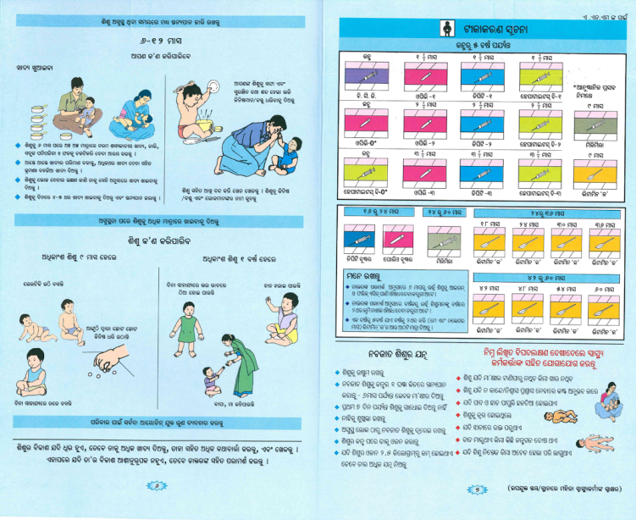
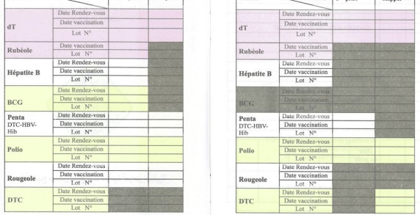
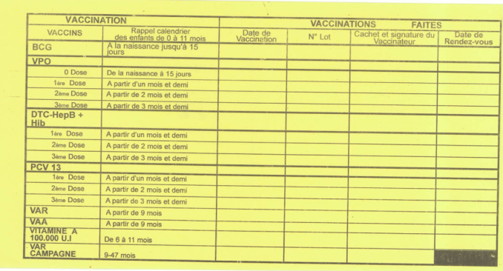
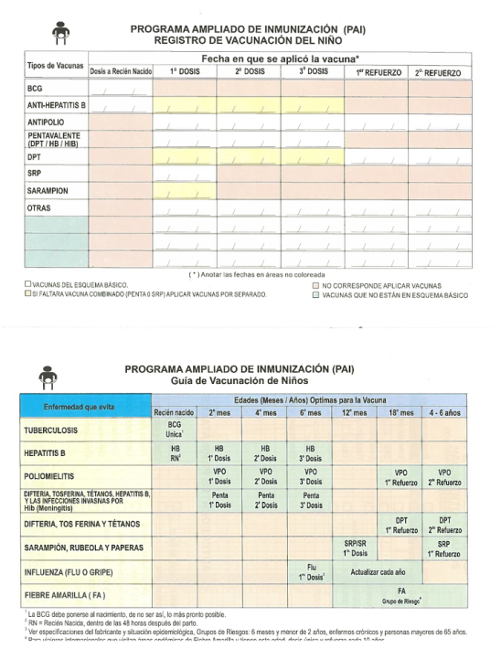
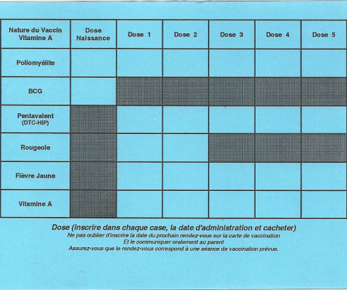
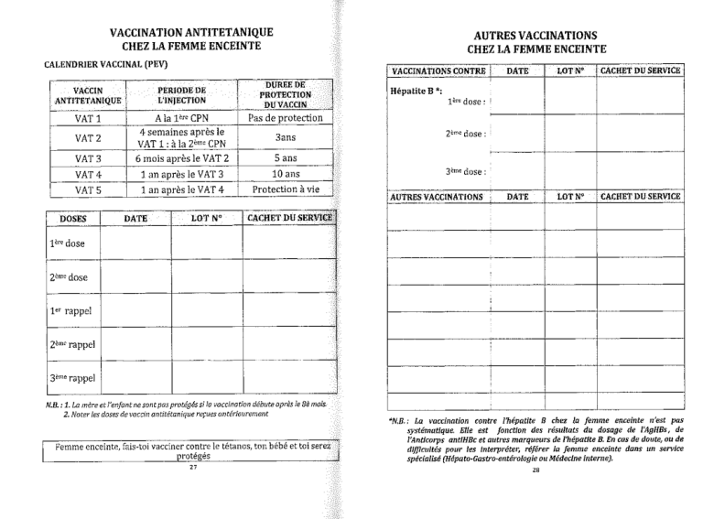
Immunization cards

Slide 30
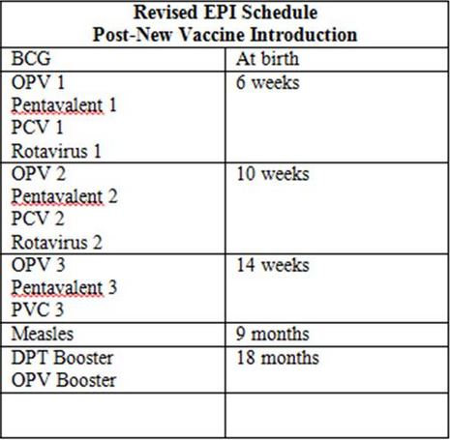
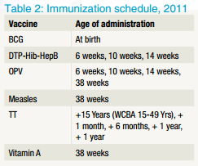
Immunization
Routine immunization
Track immunizations received and dates of immunization

Slide 31
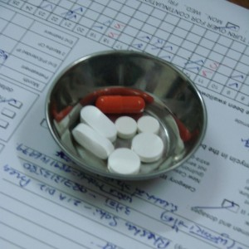
Infectious Disease
Tuberculosis
Processes established for identification and treatment
Strict regimen of treatment
Two months of Isoniazid, Rifampicin, Pyrazinamide, Ethambutol
Four months of Isoniazid, Rifampicin
Testing at completion
TB Record
Testing dates
Medication

Slide 32
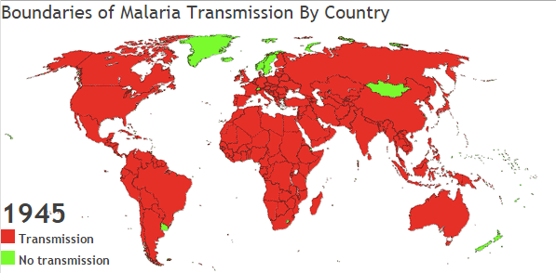
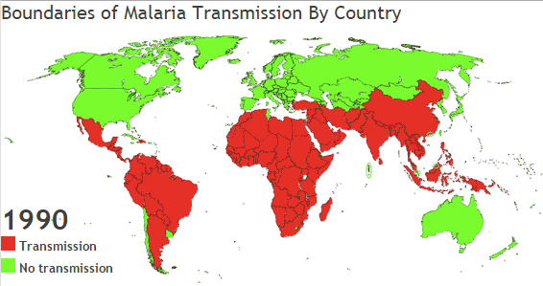
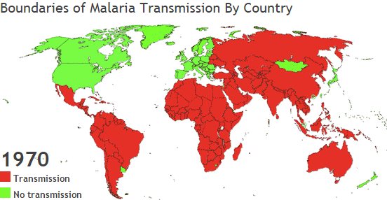
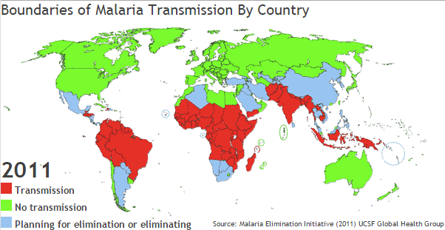
Case tracking
Identification of carriers of specific diseases
Malaria (for complete eradication)
Measles (exposure tracking)
Acute Flaccid Paralysis (AFP)

Slide 33
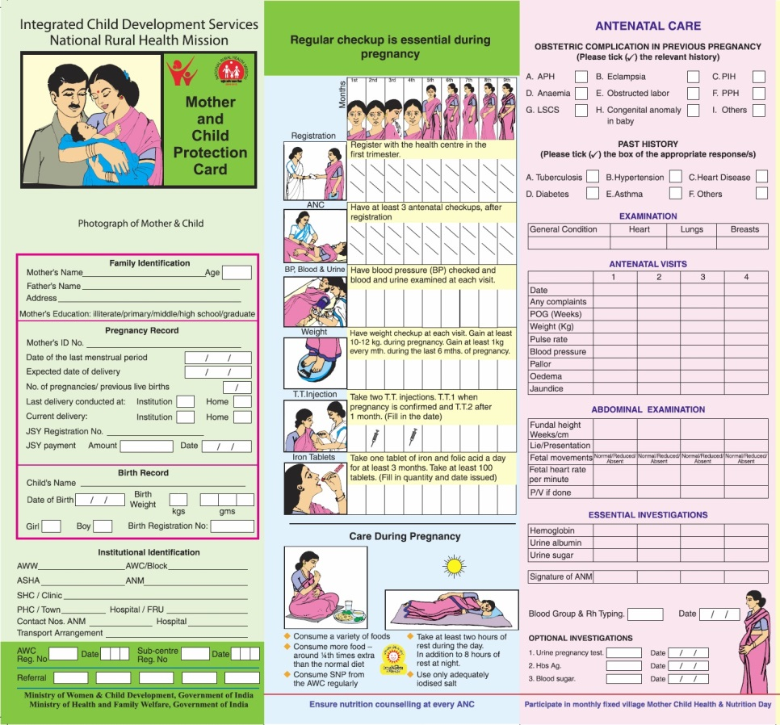
Maternal Health
Tracking mothers through pregnancy
Registration of pregnant women
Antenatal care visits

Slide 34
Health use cases
Surveillance
More accurate than reporting events
Better estimates of coverage
Tracing defaulters
Disease elimination
Care and program planning
Reporting
Reminders
Formalizing care
Coordination of care across providers

Slide 35
Challenges
Unique identifier
Biometrics
Name resolution
On-line, off-line mode
Undocumented people
Conflict zones
Privacy

Slide 36
How do we track people
5bd99967-9f94-4995-8b4c-dbf7ef23da72
National or patient ID
How are IDs assigned
Alternate IDs
Facebook, email, mobile number
Mother’s name
Name
Name and birthdate
Name and birthdate and village
Name and birthdate and village and father’s name
Name and birthdate and village and father’s name and fathers village

Slide 37
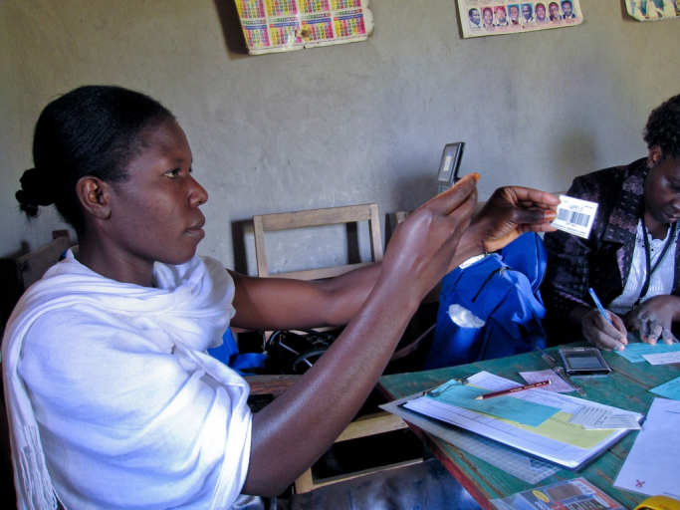
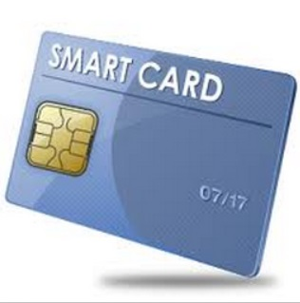
Patient ID
Generate health ID
Provide to patient on paper or a smart card

Slide 38
Biometrics
Some large initiatives based on biometrics
Finger prints, Iris
Finger prints are challenging for young children

Slide 39
Name resolution
Additional challenges in the developing world
Lack of records
Spelling of names
Imprecise dates

Slide 40
On-line, off-line access
Standard synchronization problems
In practice this is much harder than it should be

Slide 41
Undocumented people
Clearly, this is a complicated, political issue
Delivery of services to people without official status
Maintain separate registration
Alternate means of identification

Slide 42
Register/Tracker Implementations
Many stand alone implementation
Simple database backend
Extract information from a medical record system
Extension of DHIS2
Tracker is a new data model

